Slide 1
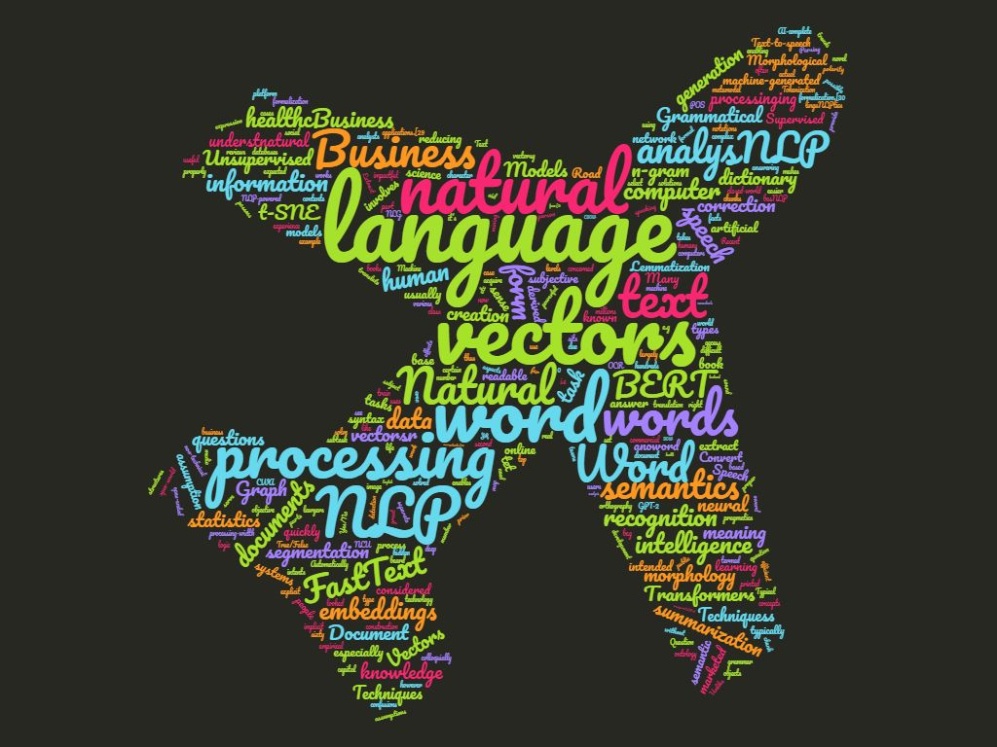
AIET Project
Semantic
Textual Similarity
(NLP)
Team
Priyambada Ambastha - Mentor
Durga Prasad
Prith Sharma
Yamini Harikrishnan
Feb 6th, 2021

Slide 2
TABLE OF CONTENTS
01
04
02
05
03
06
Aim & Motivation
Techniques Used
Demo
Results and Conclusion
Future Work
Visualization & Literature Survey

Slide 3
Aim
Semantic textual similarity deals with determining how similar two pieces of text are.
Explore various Unsupervised Sentence Similarity Techniques.
Motivation
Drive AI adoption in our Organizations.
Scope NLP use cases that will benefit Clients.

Slide 4

Idea to solve a real world problem
Problem Statement
Online Education Evaluation System Challenges are –
Limited to mostly Objective type
Inconsistencies due to case or space sensitive forms which do not score alternate answers
Stressful for Teachers to evaluate Descriptive answers from students via whatsapp
Proposed Solution
Student’s descriptive answer is matched with the Expected answer and assigned a Similarity score automatically using Unsupervised Semantic Textual Similarity techniques.

Slide 5
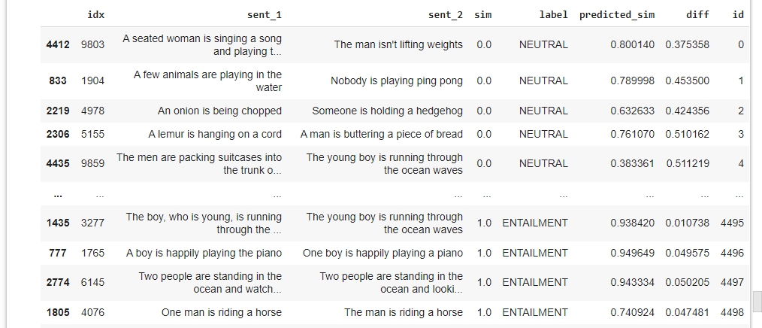
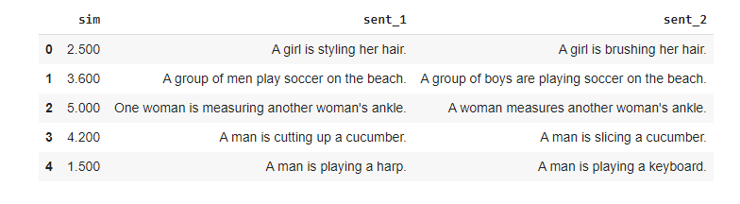
Datasets
SICK Dataset
STS Dataset
SICK dataset – Sentences Involving Compositional Knowledge
It has 9927 sentences pairs.
Train set = 4500 pairs
Dev set = 500 pairs
Test set = 4927 pairs
STS dataset – includes text from image captions, news
headlines and user forums. It has 6042 sentence pairs.
Train set = 4137 pairs
Dev set = 882 pairs
Test set = 1023 pairs

Slide 6
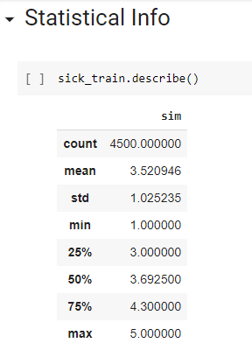
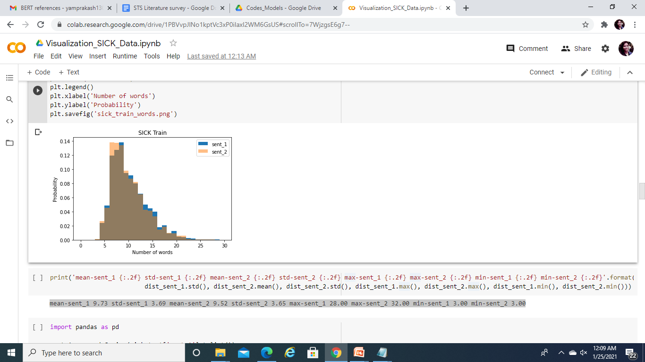
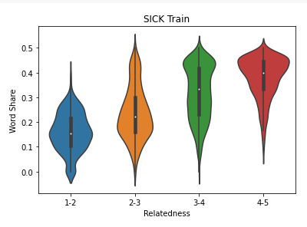
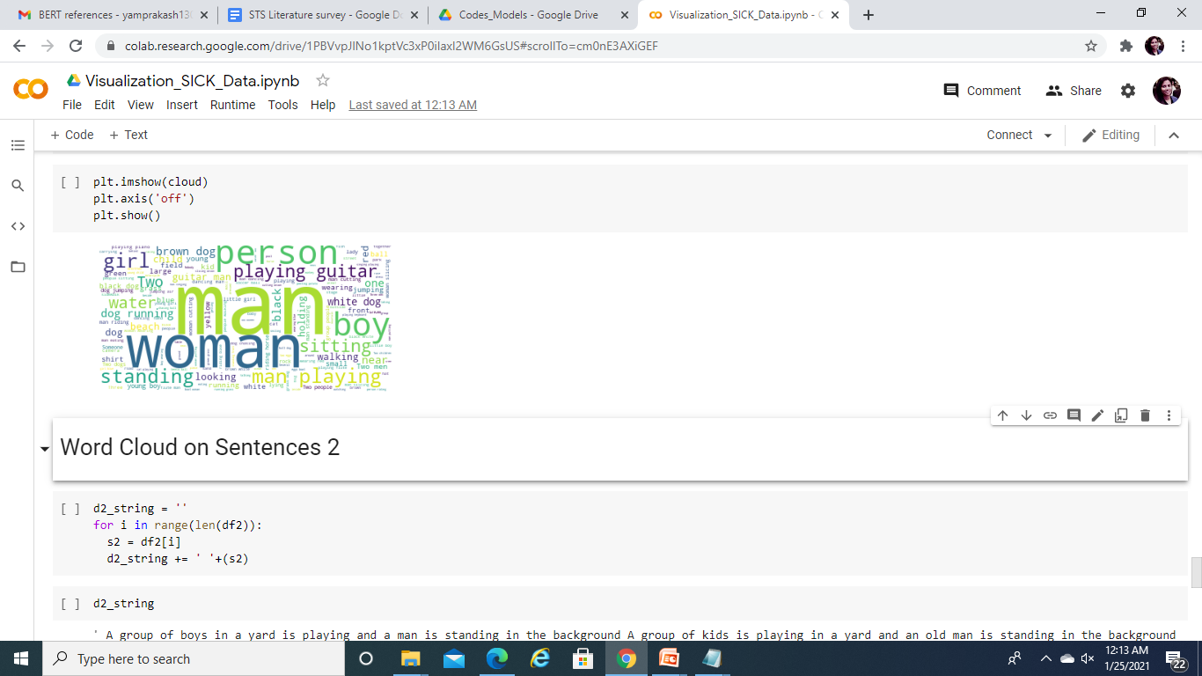
Visualization Techniques
Histogram Plots
Violin Plots
mean-sent_1 9.73
std-sent_1 3.69
mean-sent_2 9.52
std-sent_2 3.65
max-sent_1 28.00
max-sent_2 32.00
min-sent_1 3.00
min-sent_2 3.00
Word Clouds

Slide 7
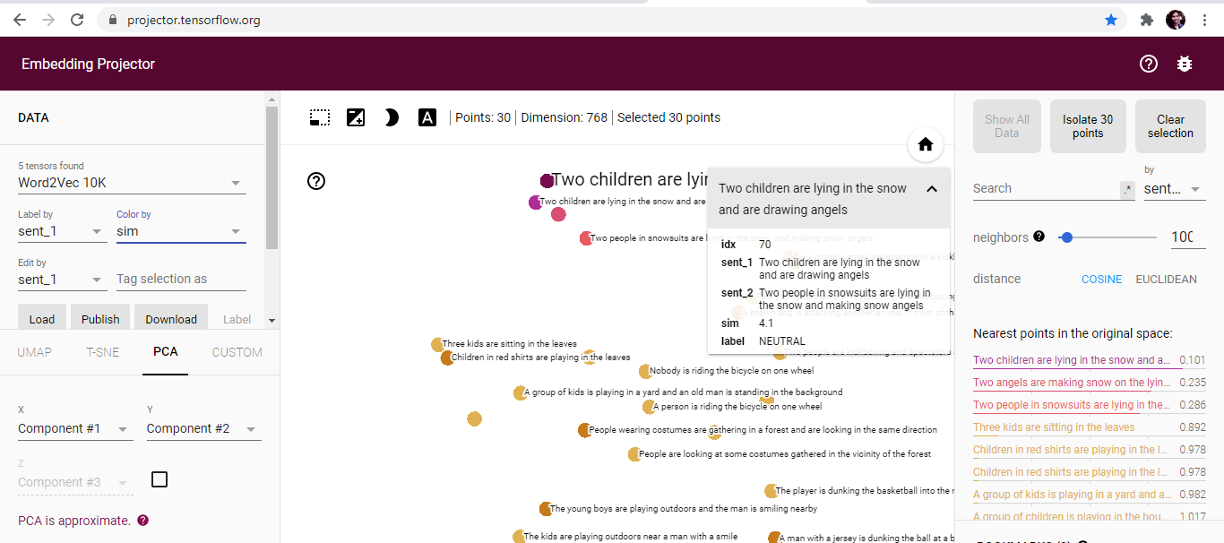
Visualization Techniques
Embedding Projector
https://projector.tensorflow.org/
8

Slide 8

Literature Surveys
Enhancing Unsupervised Sentence Similarity Methods with Deep Contextualized Word Representations https://www.aclweb.org/anthology/R19-1115.pdf
GloVe: Global Vectors for Word Representation https://nlp.stanford.edu/pubs/glove.pdf
Deep contextualized word representations – ELMo https://arxiv.org/pdf/1802.05365.pdf
Using Graphs for Word Embedding with Enhanced Semantic Relations
D19-5305_Graph.pdf
BERT: Pre-training of
Deep Bidirectional
Transformers for Language Understanding https://arxiv.org/pdf/1810.04805.pdf

Slide 9
Steps to find Text Similarity
Feature Vectors of Sentence 1
Sentence 1
Tokenization
Word Embeddings
/ Contextual Word Embeddings
Vector Similarity
Sentence 2
Feature Vectors of Sentence 2

Slide 10
Unsupervised Techniques Used
Word
Embeddings
Word2Vec
GloVe
FastText
ELMo
BERT
2 layer neural network
CBOW
SKIP Gram
Google
Global Matrix Factorisation
Local Context Window
Stanford
Word as
an n-gram of characters
Facebook
Deep context dependant representations
Semi Supervised
Bidirectional Encoder Representations from Transformers
Sentence
Embeddings
Using Pre-trained Sentence Transformers/BERT

Slide 11
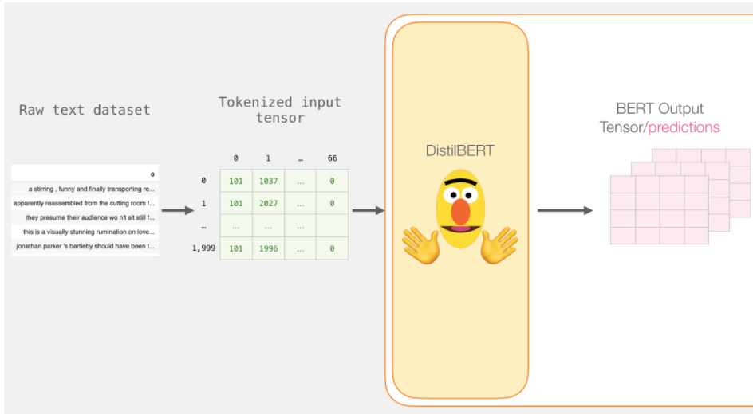
Extracting Word embeddings from Sentences
http://jalammar.github.io/a-visual-guide-to-using-bert-for-the-first-time/
11

Slide 12
Similarity Measures
Cosine
Word Mover’s Distance
Smooth Inverse Frequency

Slide 13
Evaluation Metrics
Pearson
MSE
Spearman
Pearson’s Correlation Coefficient is the Covariance of the two variables divided by the product of their standard deviation.
Mean Squared Error measures the average of the squares of the errors , that is, the average squared difference between the estimated values and the actual value.
It is always non negative , and values closer to zero are better.
Spearman Correlation Coefficient measures the strength and direction of the association between two ranked variables.

Slide 14
Cosine
SICK Train data Results
Word Mover’s Distance
Model | Pearson | Spearman | MSE
W2V NStop | 0.703 0.706 | 0.612 0.600 | 0.073 0.062
FastText NStop | 0.647 0.646 | 0.565 0.564 | 0.106 0.106
GloVe NStop | 0.660 0.686 | 0.568 0.559 | 0.121 0.070
ELMo NStop | 0.656 0.677 | 0.593 0.599 | 0.075 0.070
BERT | 0.826 | 0.790 | 0.160
Model | Pearson | Spearman | MSE
W2V NStop | 0.612 0.615 | 0.573 0.567 | 0.477 0.476
FastText NStop | 0.564 0.564 | 0.540 0.539 | 0.477 0.477
GloVe NStop | 0.611 0.628 | 0.571 0.566 | 0.477 0.476
Smooth Inverse Frequency
Model | Pearson | Spearman | MSE
W2V NStop | 0.723 0.732 | 0.627 0.620 | 0.041 0.041
FastText NStop | 0.645 0.643 | 0.570 0.568 | 0.059 0.059
GloVe NStop | 0.688 0.714 | 0.599 0.585 | 0.048 0.048
ELMo NStop | 0.615 0.636 | 0.567 0.569 | 0.073 0.069

Slide 15
SICK Test data Results
Cosine
Word Mover’s Distance
Model | Pearson | Spearman | MSE
W2V NStop | 0.704 0.701 | 0.610 0.597 | 0.071 0.060
FT NStop | 0.633 0.697 | 0.550 0.585 | 0.105 0.073
GloVe NStop | 0.659 0.681 | 0.567 0.558 | 0.118 0.068
ELMo NStop | 0.653 0.673 | 0.588 0.596 | 0.073 0.067
BERT | 0.822 | 0.784 | 0.160
Model | Pearson | Spearman | MSE
W2V NStop | 0.612 0.609 | 0.567 0.559 | 0.477 0.477
FT NStop | 0.565 0.610 | 0.536 0.566 | 0.477 0.477
GloVe NStop | 0.608 0.627 | 0.568 0.565 | 0.477 0.476
Smooth Inverse Frequency
Model | Pearson | Spearman | MSE
W2V NStop | 0.725 0.727 | 0.629 0.621 | 0.040 0.041
FT NStop | 0.639 0.704 | 0.564 0.594 | 0.059 0.046
GloVe NStop | 0.687 0.707 | 0.597 0.585 | 0.047 0.048
ELMo NStop | 0.602 0.633 | 0.554 0.573 | 0.074 0.069

Slide 16
STS Train data Results
Cosine
Word Mover’s Distance
Model | Pearson | Spearman | MSE
W2V NStop | 0.630 0.665 | 0.616 0.644 | 0.119 0.104
Fast Text NStop | 0.379 0.640 | 0.376 0.615 | 0.228 0.193
GloVe NStop | 0.544 0.674 | 0.567 0.671 | 0.198 0.141
ELMo NStop | 0.637 0.520 | 0.619 0.615 | 0.137 0.137
BERT | 0.990 | 0.990 | 0.003
Model | Pearson | Spearman | MSE
W2V NStop | 0.487 0.554 | 0.487 0.548 | 0.367 0.367
Fast Text NStop | 0.420 0.565 | 0.411 0.572 | 0.368 0.367
GloVe NStop | 0.531 0.663 | 0.525 0.653 | 0.367 0.366
Smooth Inverse Frequency
Model | Pearson | Spearman | MSE
W2V | 0.692 | 0.653 | 0.064
Fast Text NStop | 0.434 0.644 | 0.428 0.614 | 0.106 0.078
GloVe | 0.677 | 0.653 | 0.077
ELMo | 0.653 | 0.624 | 0.062

Slide 17
STS Test data results
Cosine
Word Mover’s Distance
Model | Pearson | Spearman | MSE
W2V NStop | 0.600 0.649 | 0.592 0.639 | 0.144 0.118
Fast Text NStop | 0.417 0.528 | 0.418 0.587 | 0.265 0.230
GloVe NStop | 0.466 0.649 | 0.511 0.655 | 0.233 0.162
ELMo NStop | 0.619 0.520 | 0.614 0.615 | 0.152 0.137
BERT | 0.863 | 0.873 | 0.173
Model | Pearson | Spearman | MSE
W2V NStop | 0.494 0.562 | 0.505 0.562 | 0.384 0.383
Fast Text NStop | 0.468 0.543 | 0.46 0.572 | 0.385 0.383
GloVe NStop | 0.505 0.650 | 0.514 0.644 | 0.384 0.382
Smooth Inverse Frequency
Model | Pearson | Spearman | MSE
W2V NStop | 0.673 0.697 | 0.64 0.668 | 0.073 0.065
Fast Text NStop | 0.519 0.589 | 0.501 0.592 | 0.114 0.113
GloVe NStop | 0.641 0.707 | 0.618 0.694 | 0.09 0.069
ELMo | 0.628 | 0.612 | 0.068

Slide 18
Conclusions
SICK Dataset
1)For learning purposes we experimented embeddings with and without stop words and found a significant improvement in Cosine results without stop words.
2)BERT embedding gave similar results for SICK train and SICK test data as the size of the datasets were almost same (SICK_TRAIN = 4500 pairs SICK_TEST = 4927 pairs )
3)BERT Cosine results were the best so we integrated Similitude app on BERT Model.
STS Dataset
1)For learning purposes we experimented embeddings with and without stop words and found a significant improvement in All Similarity measure results without stop words.
2)BERT embedding results were highest in STS Train set (4137 pairs) for Cosine.

Slide 19
Future Work
Graph Embeddings
Enhance the model built for Online Education Evaluation tasks

Slide 20
Thank You

